Slide 1
FRPA 101-E3 Riparian Management Standards Region III

Slide 2
Agenda
Background, history, and intent
Types of riparian standards
Riparian areas by landowner
Allowed uses in riparian areas
Other riparian area BMPs
Variations from riparian standards

Slide 3
Background

Slide 4
History
1990 - Riparian management first addressed in FRPA revision – focused on Region I
1993 regulations – variations, small streams, slope stability standards
2003 – FRPA Region III riparian standards were revised with new waterbody classification system and riparian management standards
2004 – Region II regulations updated
Notes:
1990 FRPA version
purposes and management of riparian areas;
riparian standards for Region I
buffers on Type A waters and on public anadromous/HVR waters

Slide 5
Intent
Protect riparian areas from the significant adverse effects of timber harvest activities on fish habitat and water quality.
Take into account the economic feasibility of timber opera­tions
Adequate preservation of fish habitat.
AS 41.17.115(a), 11 AAC 95.185(a)

Slide 6
Fish Habitat Factors
short‑ and long‑term source of large woody debris
stream bank stability
channel morphology
water temperatures
stream flows
water quality
adequate nutrient cycling
food sources
clean spawning gravels
sunlight
AS 41.17.115(a)

Slide 7
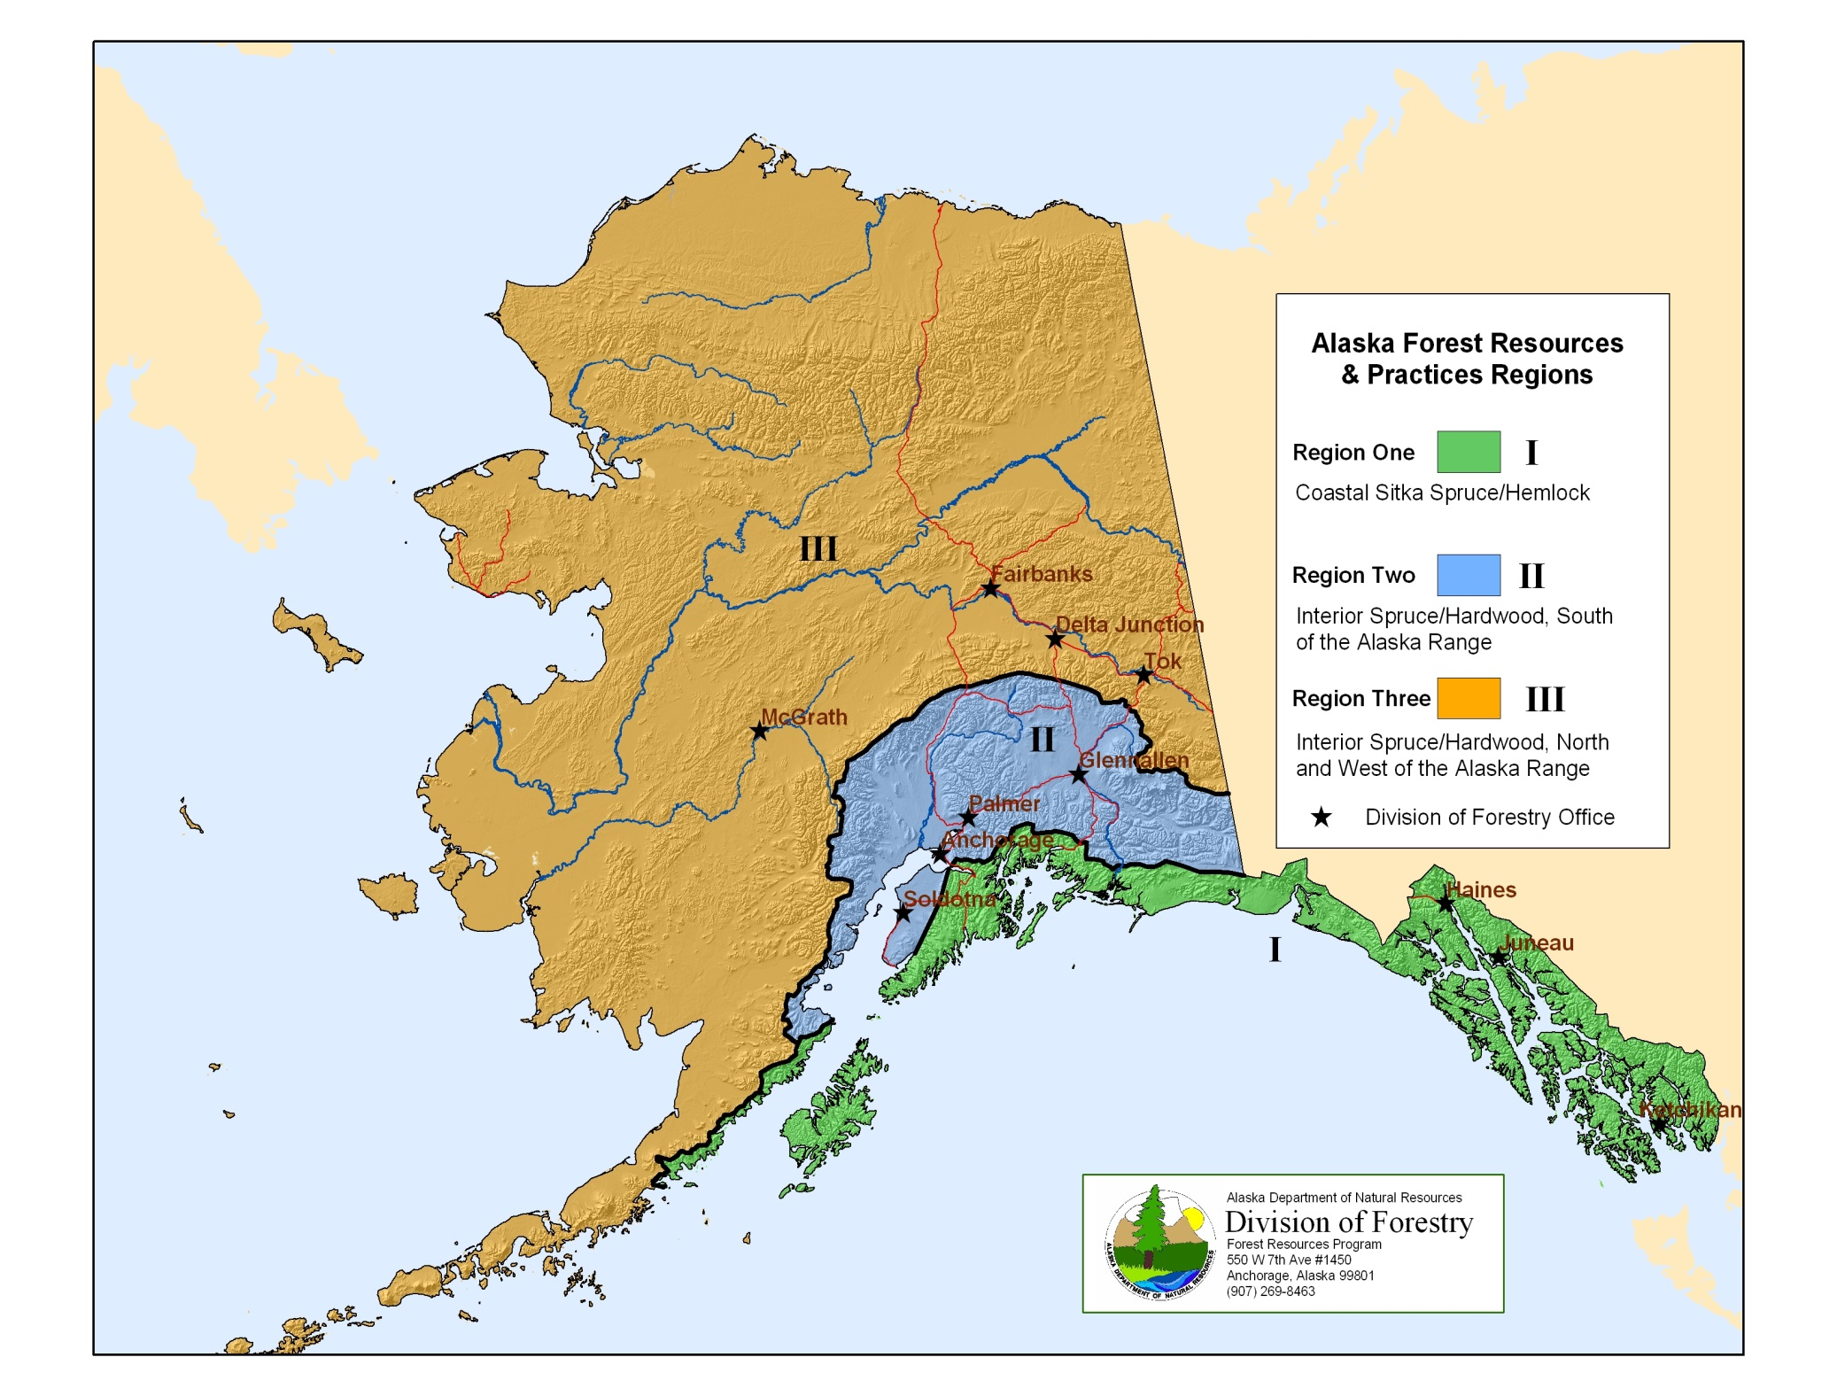

Slide 8
Definition: Riparian area - Region III
On private land: the areas subject to riparian protection standards in AS 41.17.116(c)
On state and other public land: the area 100’ from the shore or bank of an anadromous or high value resident fish water body (AS 41.17.118(a)(3)
AS 41.17.950 (23)(A),(C)

Slide 9
Measurement of distances
The distance measured must be horizontal distance rather than slope distance;
Riparian areas are measured from the OHWM
The distance from a tidal zone is measured from the line of mean higher high water mark. 11 AAC 95.280, .810
66’ slope distance
66’ slope distance
66’ horizontal
66’ horizontal
Notes:
11 AAC 95.900(53) "ordinary high water mark" or "OHWM" means the mark along the bank or shore up to which the presence and action of the tidal or nontidal water are so common and usual, and so long continued in all ordinary years, as to leave a natural line impressed on the bank or shore and indicated by erosion, shelving, changes in soil characteristics, destruction of terrestrial vegetation, or other distinctive physical characteristics;

Slide 10
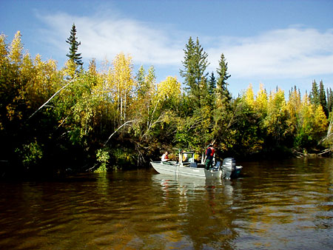
Region III water body classes – Type III-A
A non-glacial high value resident fish water body >3 feet wide at the OHWM;
A non-glacial anadromous water body; or
A backwater slough. AS 41.17.950 (39)
Type III-A water: Birch Creek
Notes:
Backwater slough definition: A water body that
has sluggish flow, is warm in summer, and is typically only connected to the main stem or a side channel at one end of the water body;
carries river current only under high water conditions; and
may have only a seasonal connection to the main stem or side channel
OHWM = ordinary high water mark

Slide 11
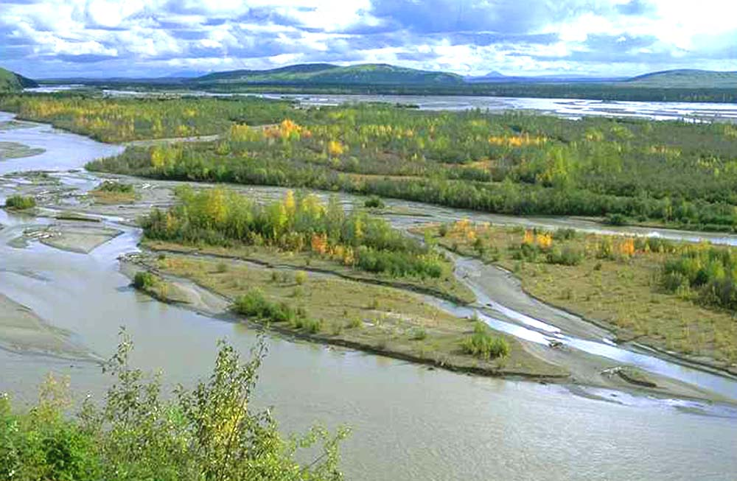
Region III water body classes – Type III-B
A glacial high value resident fish water body or a glacial anadromous water body;
Type III-B water bodies do not include glacial backwater sloughs
AS 41.17.950 (40)
Type III-B water: Tanana R.

Slide 12
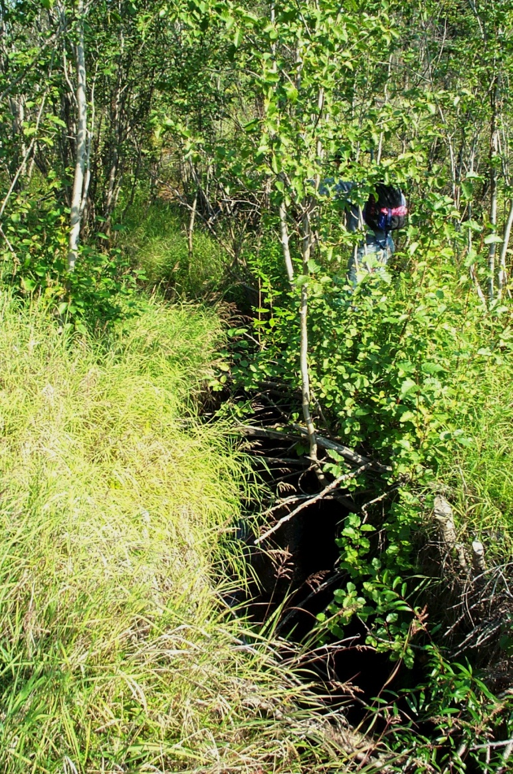
Region III water body classes – Type III-C
A non-glacial high value resident fish water body that is <3’ wide at the OHWM and that does not contain anadromous fish.
AS 41.17.950 (38)
Typically these are the lower reaches of small streams in close proximity to III-A streams; many are unnamed
Keystone Creek
Notes:
For more information on water body classification, see FRPA 101-D3
From Doug Hanson: In Interior AK I would say these streams would generally be located in close proximity to III-A streams. Upper reaches in upland areas are very unlikely to have fish. With 3-foot OHWM you are looking at something more like 1-2 feet in normal summer flow.
OHWM = ordinary high water mark

Slide 13
Riparian standards

Slide 14
Types of standards
DPO information
No-cut buffer
Special management zone
Maintain important fish and wildlife habitat
Other riparian BMPs

Slide 15
DPOs
DPOs must include:
The location and classification of known surface waters adjacent to or within harvest units
Any request for variation from riparian standards
11 AAC 95.220(5)(A),(14),.235

Slide 16
Private lands

Slide 17
Type III-A
.
No timber harvest of timber within 66’ of the water body
AS 41.17.116 (c)(1)
Notes:
Type III-A waters:
Non-glacial water bodies that are >3 feet wide and have high-value resident fish,
Non-glacial water bodies with anadromous fish, or
Backwater sloughs.

Slide 18
Type III-B
No timber harvest within 33’ of the water body;
Between 33’ and 66’ from the water body, up to 50% of standing white spruce trees >9” DBH may be harvested without requiring a variation;
AS 41.17.116 (c)(2)

Slide 19
Type III-C:
Harvest of timber within 100’ of the water body must be located and designed primarily to protect fish habitat and surface water quality as determined by DNR with due deference to ADF&G.
AS 41.17.116 (c)(3)
Notes:
See FRPA 101-A and AS 41.17.098 for more information on due deference

Slide 20
State & other public land

Slide 21
Type III-A
.
No timber harvest within 100’ of the water body;
However, between 66’ and 100’ from the water body, harvest of timber may be undertaken where consistent with the maintenance of important fish and wildlife habitat as determined by DNR with the concurrence of ADF&G
AS 41.17.118 (a)(3)(A), .119(3)

Slide 22
Type III-B
No timber harvest within 50’ of the water body;
Between 50’ and 100’ from the water body, up to 50% of standing white spruce trees >9” DBH may be harvested without requiring a variation;
AS 41.17.118 (a)(3)(B), .119(3)

Slide 23
Type III-C:
Harvest of timber within 100’ of the water body must be consistent with the maintenance of important fish and wildlife habitat as determined by DNR with due deference to ADF&G
AS 41.17.118 (a)(3)(B), .119(3)

Slide 24
Planning on state land
DNR area and management plans (adopted under AS 38.04.065) may impose additional riparian protection standards for timber harvest operations
On legislatively designated State Forests, riparian standards adopted by DNR may not exceed the FRPA standards unless the commissioner makes a finding of “compelling state interest.”
AS 41.17.118(b)
Bristol Bay AP Tanana Valley SFMP
E. Tanana AP Upper Yukon AP
Kuskokwim AP Yukon-Tanana AP
Northwest AP Eastern Tanana AP
Notes:
If a plan has higher standards than FRPA for a particular water body, DOF will identify that in the BIF and FLUP, and include site-specific requirements in timber sale contracts as appropriate.

Slide 25
REGION III – Riparian management on PRIVATE LAND
Stream Type | 33’ | 50’ | 66’ | 100’ | 150’ | 200’ | 250’ | 300’
III-A | Buffer
III-B | Buffer | * Buffer
 | *harvest allowed of up to 50% of white spruce >9” dbh
III-C | *Buffer
 | *harvest must be designed to protect fish habitat and water quality

Slide 26
REGION III – Riparian management on STATE and OTHER PUBLIC LAND
Stream Type | 33’ |  | 50’ | 66’ | 100’ | 150’ | 200’ | 250’ | 300’
IIIA | buffer |  |  |  | *
 | *harvest allowed where consistent with maintenance of important fish and wildlife habitat
IIIB | buffer | *
 | *harvest allowed of up to 50% of white spruce >9” dbh
IIIC | *
 | *harvest must be consistent with maintenance of important fish and wildlife habitat

Slide 27
New Fish-bearing Streams
DPOs must include:
An operator shall promptly inform DOF if a previously unknown fish water body is found within an operating area.
Operations in the vicinity of a newly discovered or reclassified water body that has standing timber remaining in the riparian area must comply with the riparian standards with respect to the remaining timber.
11 AAC 95.220(5)(A),(14),.235. 265(e)

Slide 28
Allowed uses in riparian areas

Slide 29
DPO notice required
Operations allowed within riparian areas must be identified in the DPO
Exception: felling and removing hazard trees along roadways as required by state or federal law is allowed and does not need to be in a DPO.
11 AAC 95.275(a),(b),(c)

Slide 30
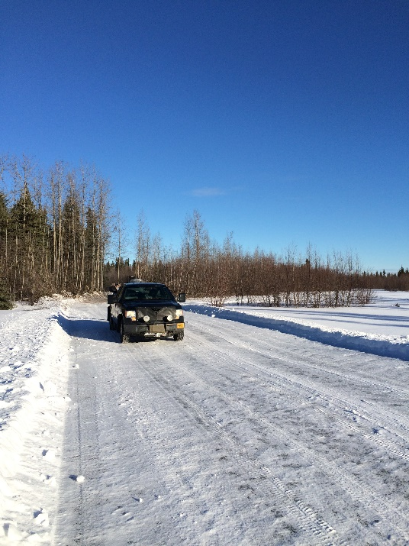
Allowed uses: roads & crossings
Road building and associated activities where access is needed to a water body crossing, or where there is no feasible alternative. A stream crossing or a road in any riparian area must be designed and located to minimize significant adverse effects on fish habitat and on water quality. 11 AAC 95.275(a)(1), .285(b)
A water body crossing built in accordance with the bridge standards. 11 AAC 95.275(a)(2),.300
Notes:
Photo: Backwater slough ice crossing on the Tanana River (Salcha). Photo from Kevin Meany, DOF.

Slide 31
Allowed uses: materials, blocks
Locating material extraction sites in braided, glacial floodplains in accordance with the regulations for material extraction and disposal sites (11 AAC 95.325); sites must be identified in a DPO.
Installing blocks, or similar devices on a tree required for retention under this chapter if the device is installed to minimize damage to the tree.
11 AAC 95.275(a)(4),(5)

Slide 32
Allowed uses: lifts, rigging, yarding
The use, as lift trees or tail holds, of trees required for retention under this chapter
Hanging of rigging through the riparian area if necessary to be consistent with operator safety requirements and to have a clear line of sight and working area for the rigging
On state and other public land, yarding corridors and other logging methods that do not cause a significant adverse impact to the riparian habitat
11 AAC 95.275(a)(6)-(8)

Slide 33
Other riparian BMPs
Note: There are additional BMPs in the following sections. This presentation includes only those subsections specific to riparian areas.

Slide 34
Felling and bucking
If feasible, an operator may not fell a tree into a riparian timber retention area.
See also the purple book section on 11 AAC 95.355(e)(1) for compliance monitoring procedures
11AAC 95.355(e)

Slide 35
Marking riparian areas
Where a riparian timber retention area abuts or is within a harvest unit, mark the limits of the riparian retention area before harvest begins.
Each marking must be visible from adjacent markings;
Marking with flagging, painting, or another identification system.
11AAC95.270 (a),(b)

Slide 36
Marking riparian areas, cont.
Mark while the area is free of snow cover that would prevent accuracy, unless a water body is large, incised, or otherwise identifiable when under snow cover.
A tree on a riparian retention area boundary is in the retention area if >50% of the diameter of the bole of the tree is in the riparian retention area as measured at 4-1/2’ feet above the ground or at the top of the root collar, whichever is higher.
11AAC95.270 (c),(d)

Slide 37
Blasting
Any discharge of explosives in riparian areas in Region III requires a variation.
11 AAC 95.235, .335(a)(2)

Slide 38
Bank integrity
In a riparian area, where feasible and necessary, leave high stumps to prevent felled and bucked timber from entering surface waters.
See also the purple book section on 11 AAC 95.350(c) for objectives and compliance monitoring procedures
11 AAC 95.350(c)
Notes:
This BMP usually applies to cable yarding terrain.
High stumps are needed where the side slopes are steep enough that felled and bucked timber will roll or slide downhill.
Stumps have to be high enough for boles or substantial branches to catch and hold on, but not every stump has to be cut high to retain felled timber on the hillside. High stumps are most effective if trees are felled parallel to the contours.
Deflection has to be adequate so one end of the log can be suspended and lifted over a high stump above it.
See also the purple book section on 11 AAC 95.350(c) for objectives and compliance monitoring procedures

Slide 39
Cable yarding
When yarding in or near a riparian area, an operator shall make an effort to minimize soil disturbance and to prevent logs from rolling into surface waters or the riparian area.
See also the purple book section on 11 AAC 95.360(c)(4) for objectives and compliance monitoring procedures
11 AAC 95.360(c)(4)

Slide 40
Cable yarding
Partially or fully suspend logs when yarding.
Select landings to minimize side-hill yarding near the stream or riparian area (e.g., position landings so logs are yarded uphill and away from the stream as much as possible).
Do not locate landings near an incised stream, especially when yarding downhill. A high lead system has limited suspension capabilities.
See also the purple book section on 11 AAC 95.360(c)(4) for objectives and compliance monitoring procedures

Slide 41
Tracked & wheeled systems
In riparian areas:
Minimize the number of skidding routes
Consistent with good safety practices, log skidding must minimize damage to retained trees, stumps, root systems, understory vegeta­tion, and soils; and
Use one-end suspension of logs.
11 AAC 95.365(b)
Notes:
For more information on tracked & wheeled harvesting systems, see FRPA 101-I: Timber harvesting and 11 AAC 95.365

Slide 42
Tracked & wheeled systems
Shovel yarding rarely requires a skid trail in the riparian area. Where feasible, position the shovel outside the riparian area and reach into the area to remove the log. Fell and buck trees within a riparian area so any log segment is reachable from outside the riparian area
An operator should be able to lift logs and swing them out of the riparian area with a very little disturbance.
On very wet sites, conduct yarding when the ground is frozen.
Purple book section re 11 AAC 95.365(b)
Notes:
See the purple book section on 11 AAC 95.365(b) for objectives, compliance monitoring procedures, and exceptions

Slide 43
Slash burning
When slash is disposed of by burning, protect a riparian area from fire, and burn under weather conditions that minimize the chance of air quality degradation and fire escape.
11 AAC 95.370(b)

Slide 44
Variations

Slide 45
Variations
A forest landowner, timber owner, or operator may propose a variation to allow harvesting of specific trees within a riparian area.
DOF shall agree to the proposed variation if it determines that the harm intended to be avoided by the requirement
is not likely to occur because of site‑specific circumstances, and
is not likely to cause significant harm to fish habitat or water quality
AS 41.17.087
AS 41.17.087

Slide 46
Variations: appeals & due deference
If DOF does not agree to the proposed variation, the owner or operator may appeal to the DNR commissioner. Appellants must conform to the requirement while the appeal is pending.
DNR shall give due deference to ADF&G and DEC for variation determinations
AS 41.17.087

Slide 47
Variations: conditions
DOF will consider the impact of the variation harvest on non-merchantable trees within the riparian retention area, and may condition and document a variation authorization to protect non-merchantable trees that are important to maintain fish habitat and water quality.
11 AAC 95.235(d)

Slide 48
Region III variations: DPO
Include the following information in DPO:
A map at 1:12,000 scale or finer that clearly shows the water body and the approximate location of the requested trees;
The length of reach along which the variation trees are requested;
The water body classification and average channel width of the reach along which the variation trees are requested;
A description of the species and the DBH range of the trees requested for harvesting;
11 AAC 95.220(14)(B)

Slide 49
Region III variations: DPO, cont.
The minimum distance from OHWM to the proposed variation harvest; and
The percentage of trees >9” DBH within the reach for which any variation is sought that the operator is requesting to harvest, and that were harvested under a prior variation request, if any.
11 AAC 95.220(14)(B)

Slide 50
QUESTIONS?

Slide 51
Addenda
Key to classification system
Examples of stream types

Slide 52
Key to Region III waterbody classification
Does the waterbody have anadromous or high value resident fish at least seasonally?
No
Other surface waters
Yes
Is it a non-glacial stream <3’ wide at OHWM with HVR but not anadrmous fish?
Is it a glacial water body other than a backwater slough?
No
Yes
Yes
No
Type III-C: Small HVR streams
Type III-B: Glacial waters other than backwater sloughs
Type III-A: Non-glacial HVR waters >3’ wide, non-glacial anadromous waters, & backwater sloughs

Slide 53
Type III-A examples
Anvik River
Birch Cree
Birch Lake
Chatanika River
Chena River
Deadman Lake
Delta Clearwater R.
Faith Creek
Fivemile Clearwater R.
George Lake
Glacier Creek
Goldstream Creek
Goodpaster River
Harding Lake
Healy Lake
Hess Creek
Jim River
Julius Creek
Kateel River
Koyukuk River
Lignite Creek
Long Creek
Medicine Lake Otter Creek
Piledriver Slough
Porcupine River
Quartz Lake
Richardson Clearwater River
Salcha River
Shaw Creek
Tolovana River
Volkmar Lake

Slide 54
Type III-A: Ex. backwater sloughs
Totchaket Slough
Unnamed sloughs in the Chena system
Many unnamed backwaters along the Tanana River

Slide 55
Type III-B examples
Chisana River
Kuskokwim River
Nenana River
Phelan Creek
Salchaket Slough
17-Mile Slough (Nenana)
Soldier Slough
Swan Neck Slough
Tanana River
Teklanika River
Tok River
Toklat River
Wood River
Yukon River

